Slide 1

  Distributed Real-Time Cyberattack detection using cloud stream processing and graph analytics
  Guided By Presented By:
Team no. 1
CSA1520 – Cloud computing and Big Data analytics
  Dr.A.M.Arul Raj
  Professor
  SIMATS Engineering
  Aakash V - 192511001
  Dharshan A N - 192525370
  Abhinav Charles – 192524168
  Rajapriyan T - 1921260194
Notes:
1
1

Slide 2
Abstract
Increasing cyber threats and security challenges in cloud environments.
Proposed distributed system for real-time cyberattack detection.
Continuous collection of cloud logs and network events using Apache Kafka.
Real-time security event processing using Apache Flink.
Graph analytics to identify suspicious relationships and attack patterns.
Rule-based detection and anomaly analysis for potential threats.

Slide 3
Aim and Objective
Aim:
To develop a distributed cloud-based system for real-time cyberattack detection using stream processing and graph analytics.
Objectives:
Monitor network events and cloud activities continuously.
Process streaming security data in real time.
Analyze relationships between users, IP addresses, and devices using graph analytics.
Detect suspicious patterns and coordinated cyberattacks.
Generate immediate alerts for potential threats.
Maintain threat logs for security monitoring and investigation.

Slide 4
Introduction
Increasing cyberattacks on cloud-based systems and networks.
Need for continuous, real-time security monitoring.
Cloud stream processing for high-speed event analysis.
Graph analytics to identify suspicious connections and attack patterns.
Early threat detection through distributed processing.
Automated alerts for faster security response.
Improved scalability, efficiency, and cloud security.

Slide 5
Literature Review
S.No | Year of Publication | Title of the Journal / Book | Methodology Used | Algorithm Used | Key Findings
1 | 2024 | Secure Cloud Computing: Leveraging GNN and Leader K-means for Intrusion Detection Optimization | Graph-based intrusion detection and clustering | GNN, Leader K-means, Grasshopper Optimization | Improved intrusion detection accuracy and efficiency in cloud environments.
2 | 2025 | DIGNN-A: Real-Time Network Intrusion Detection with Integrated Neural Networks Based on Dynamic Graph | Dynamic graph modeling and attention-based detection | Graph Neural Network, Graph Convolution | Effective real-time detection using changing network relationships
3 | 2025 | Advanced Cloud Intrusion Detection Framework Using Graph-Based Features, Transformers and Contrastive Learning | Graph feature extraction and deep learning | GNN, Transformer Autoencode | High detection accuracy and reduced false positives in cloud intrusion detection.
4 | 2025 | Real-Time Threat Detection Using Stream Analytics and Deep Learning on Network Logs | Real-time stream processing and deep learning | Apache Kafka, Apache Flink, LSTM, 1D-CNN | Scalable threat detection with low latency on streaming network logs.
5 | 2024 | A Real-time APT Attack Detection Scheme Based on Fusion Provenance Graph in Private Clouds | Provenance graph analysis and temporal behavior modeling | Recurrent Neural Network, Local Attention | Improved detection of advanced persistent threats in private clouds.

Slide 6
Problem Statement
Increasing complexity of cyberattacks in cloud environments.
Limitations of traditional security systems in real-time detection.
Delays in processing large volumes of network events.
Difficulty identifying hidden attack patterns and relationships.
Need for scalable detection, immediate alerts, and automated responses.

Slide 7
Existing System
Traditional rule-based intrusion detection systems.
Periodic analysis of network logs and cloud activities.
Signature-based detection of known cyberattacks.
Limited analysis of relationships between users, devices, and IP addresses.
Delayed threat detection and limited automated response capabilities.

Slide 8
Proposed System
Distributed cloud-based real-time cyberattack detection.
Continuous stream processing of network events.
Graph analytics to identify suspicious relationships and attack patterns.
Real-time threat alerts and anomaly detection.
Automated security responses and centralized threat logging.

Slide 9
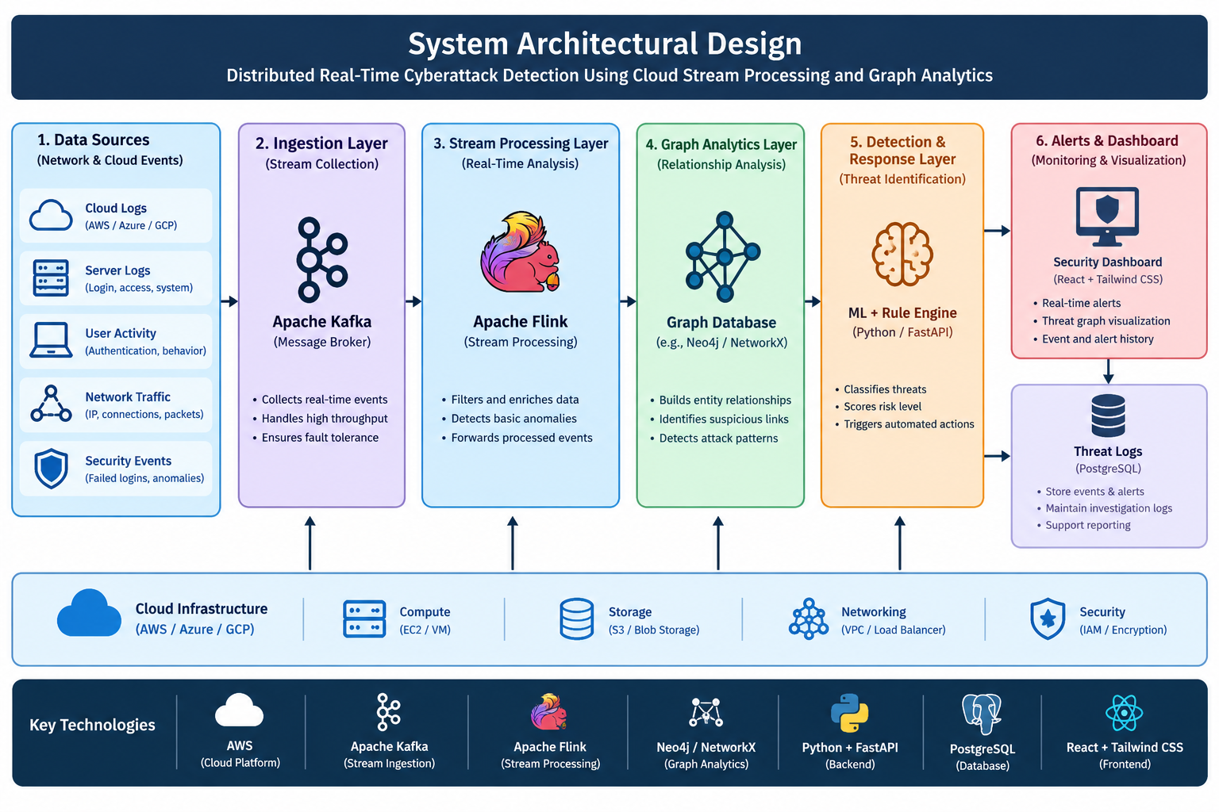
System Architecturel Design

Slide 10


Sustainable Development Goal (SDG) Implementation
SDG 9 – Industry, Innovation and Infrastructure: Secure and resilient cloud infrastructure.
SDG 16 – Peace, Justice and Strong Institutions: Protection against cyberattacks and unauthorized access.
SDG 8 – Decent Work and Economic Growth: Reliable and secure digital business operations.
SDG 11 – Sustainable Cities and Communities: Improved security for smart city and cloud-based services.
SDG 17 – Partnerships for the Goals: Collaboration in cybersecurity research and threat intelligence

Slide 11
Design & Module Planning
Module 1: Data Collection Module
Collects cloud logs and network events.
Module 2: Stream Processing Module
Processes security events in real time
Module 3: Graph Analytics Module
Identifies suspicious connections and attack patterns.
Module 4: Alert and Response Module
Generates threat alerts and triggers security actions.

Slide 12
Conclusion
Developed a proposed distributed system for real-time cyberattack detection in cloud environments.
Utilizes cloud stream processing for continuous monitoring and rapid analysis of security events.
Applies graph analytics to identify suspicious relationships and complex attack patterns.
Enables early threat identification through rule-based detection and anomaly analysis.
Provides real-time alerts, threat logging, and automated security responses.
Improves cloud security, scalability, processing efficiency, and threat visibility.

Slide 13
References
Mell, P., and Grance, T. (2011). The NIST Definition of Cloud Computing.
Scarfone, K., and Mell, P. (2007). Guide to Intrusion Detection and Prevention Systems.
NIST. Cybersecurity Framework. https://www.nist.gov/cyberframework
OWASP Foundation. OWASP Top 10. https://owasp.org/www-project-top-ten/
Microsoft Learn. Azure Security Documentation. https://learn.microsoft.com/en-us/azure/security/
NIST. Computer Security Incident Handling Guide. https://csrc.nist.gov/pubs/sp/800/61/r2/final
MITRE. MITRE ATT&CK Framework. https://attack.mitre.org/
Flask Documentation. Flask Web Development Framework. https://flask.palletsprojects.com/

